Slide 1
PHOTO COVER OPTION TITLE GOES HERE CAN RUN THREE LINES
SUBTITLE STYLE GOES HERE, CAN RUN FOUR LINES

Slide 2
RED COVER OPTION TITLE GOES HERE CAN RUN THREE LINES
SUBTITLE STYLE GOES HERE, CAN RUN FOUR LINES

Slide 3
DIVIDER TITLE GOES HERE & CAN RUN SEVERAL LINES

Slide 4

TITLE GOES HERE & CAN RUN THREE LINES
Level 1 bullet goes here.
Level 2 bullet goes here.

Slide 5
WELCOME TO FORCASTING USING R F O R EC AS T I N G I N R
Zahid Asghar
Professor of Economics, QAU

Slide 6
WHAT YOU WILL LEARN
Exploring and visualizing time series
Simple benchmark methods for forecasting
Exponential smoothing and ARIMA models
Advanced forecasting methods
Measuring forecast accuracy
Choosing the best method

Slide 7
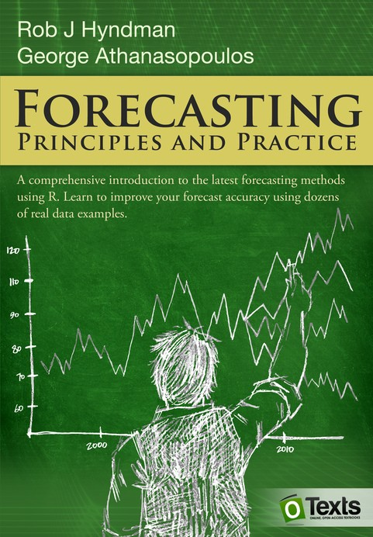
TRAINING MATERIAL
Hyndman, R. J. & Athanasopoulos, G. (2017)
Forecasting: principles and practice, 2nd edition
Free and online at OTexts.org/fpp2/
Data sets in associated R package fpp2
R code for all examples

Slide 8
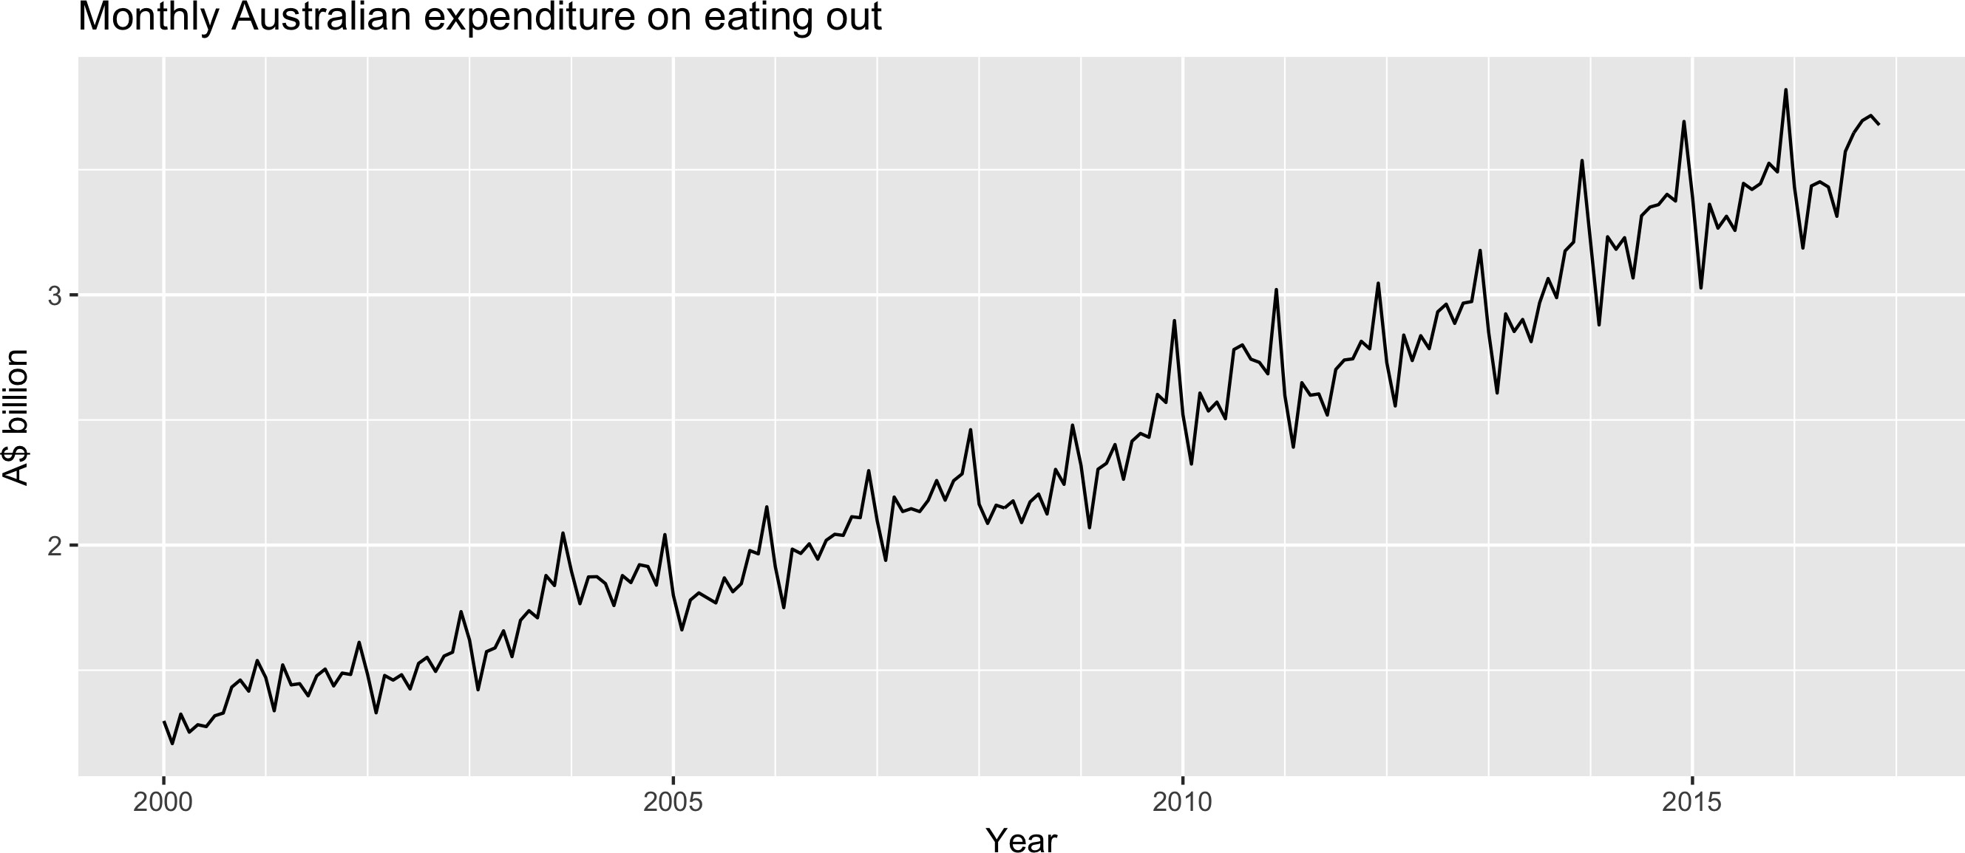
TIME SERIES DATA
Series of data observed over time
Eg.: Daily IBM stock prices, monthly rainfall in London,...
Forecasting is estimating how the sequence of observations will continue into the future.

Slide 9
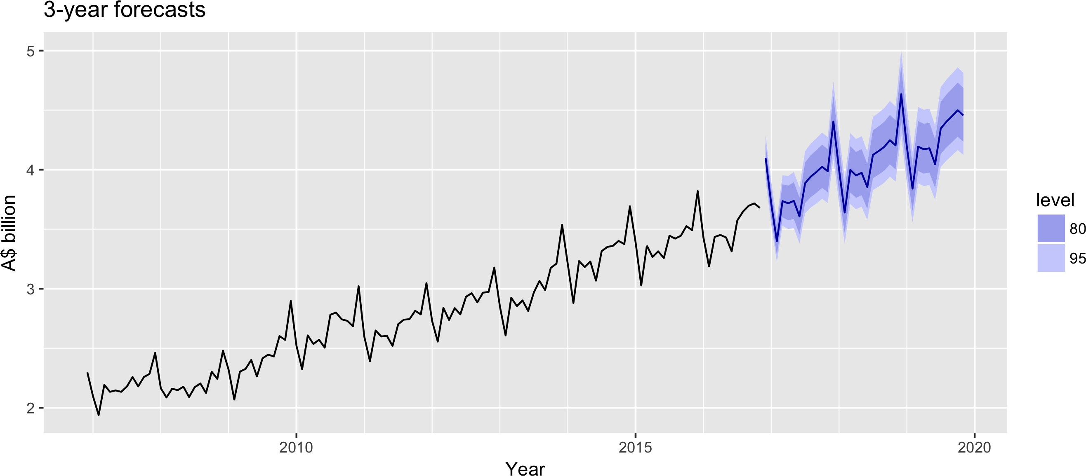
Forecasts of monthly Australian expenditure on eating out
What forecasting methods are available that take account of trend, seasonality and other features of the data?
How to measure the accuracy of your forecasts? How to choose a good forecasting model?

Slide 10
Let's practice! F O R EC AS T I N G I N R

Slide 11
TRENDS, SEASONALITY, AND CYCLICITY F O R EC AS T I N G I N R
Zahid Asghar
Professor, School of Economics, QAU

Slide 12
TIME SERIES PATTERNS
Pa ern | Description
Trend | A pattern exists involving a long-term increase OR decrease in the data
Seasonal | A periodic pattern exists due to the calendar (e.g., the quarter, month, or day of the week)
Cyclic | A pattern exists where the data exhibits rises and falls that are not of fixed period (duration usually of at least 2 years)

Slide 13
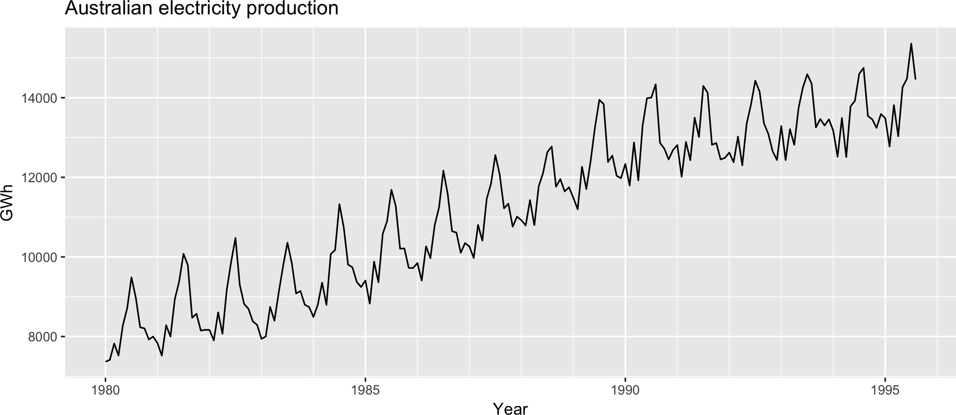
EXAMPLES OF TIME SERIES PATTERN

Slide 14
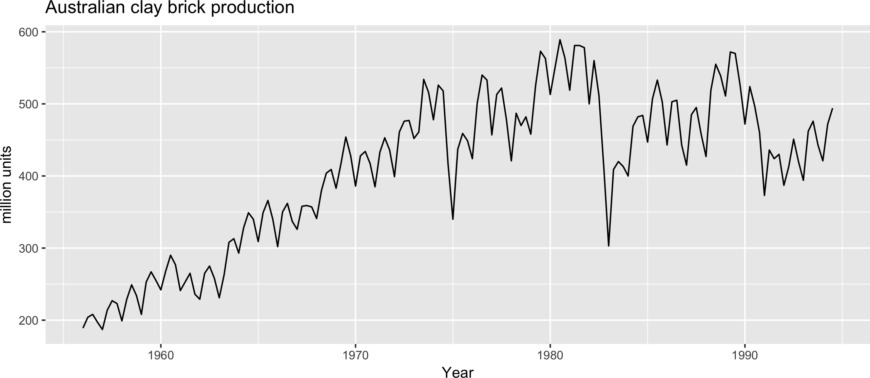
EXAMPLES OF TIME SERIES PATTERN

Slide 15
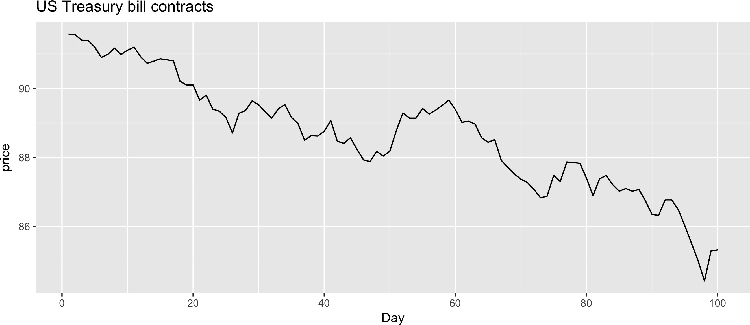
EXAMPLES OF TIME SERIES PATTERN

Slide 16
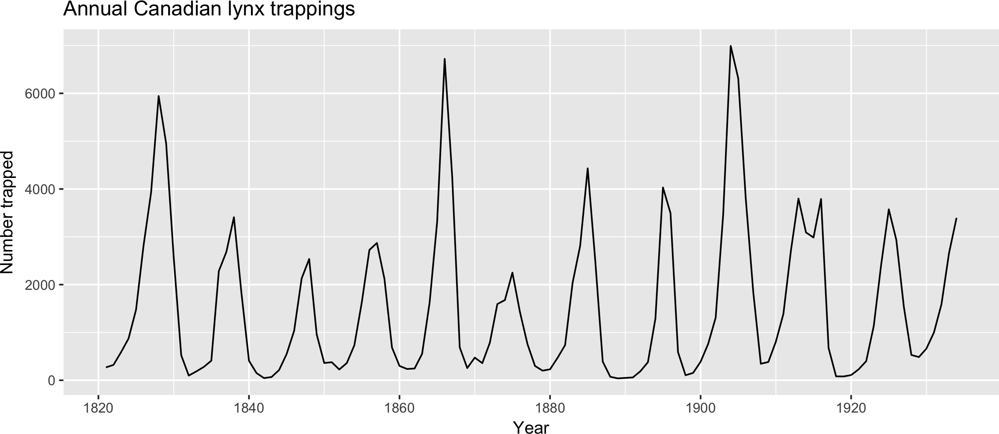
EXAMPLES OF TIME SERIES PATTERN

Slide 17
SEASONAL OR CYCLIC?
Differences between seasonal and cyclic patterns:
Seasonal pattern constant length vs. cyclic pattern variable length
Average length of cycle longer than length of seasonal pattern
Magnitude of cycle more variable than magnitude of seasonal pattern
The timing of peaks and troughs is predictable with seasonal data, but unpredictable in the long term with cyclic data.

Slide 18
Let's practice! F O R EC AS T I N G I N R

Slide 19
WHITE NOISE F O R EC AS T I N G I N R
Zahid Asghar
Professor of Economics, QAU

Slide 20
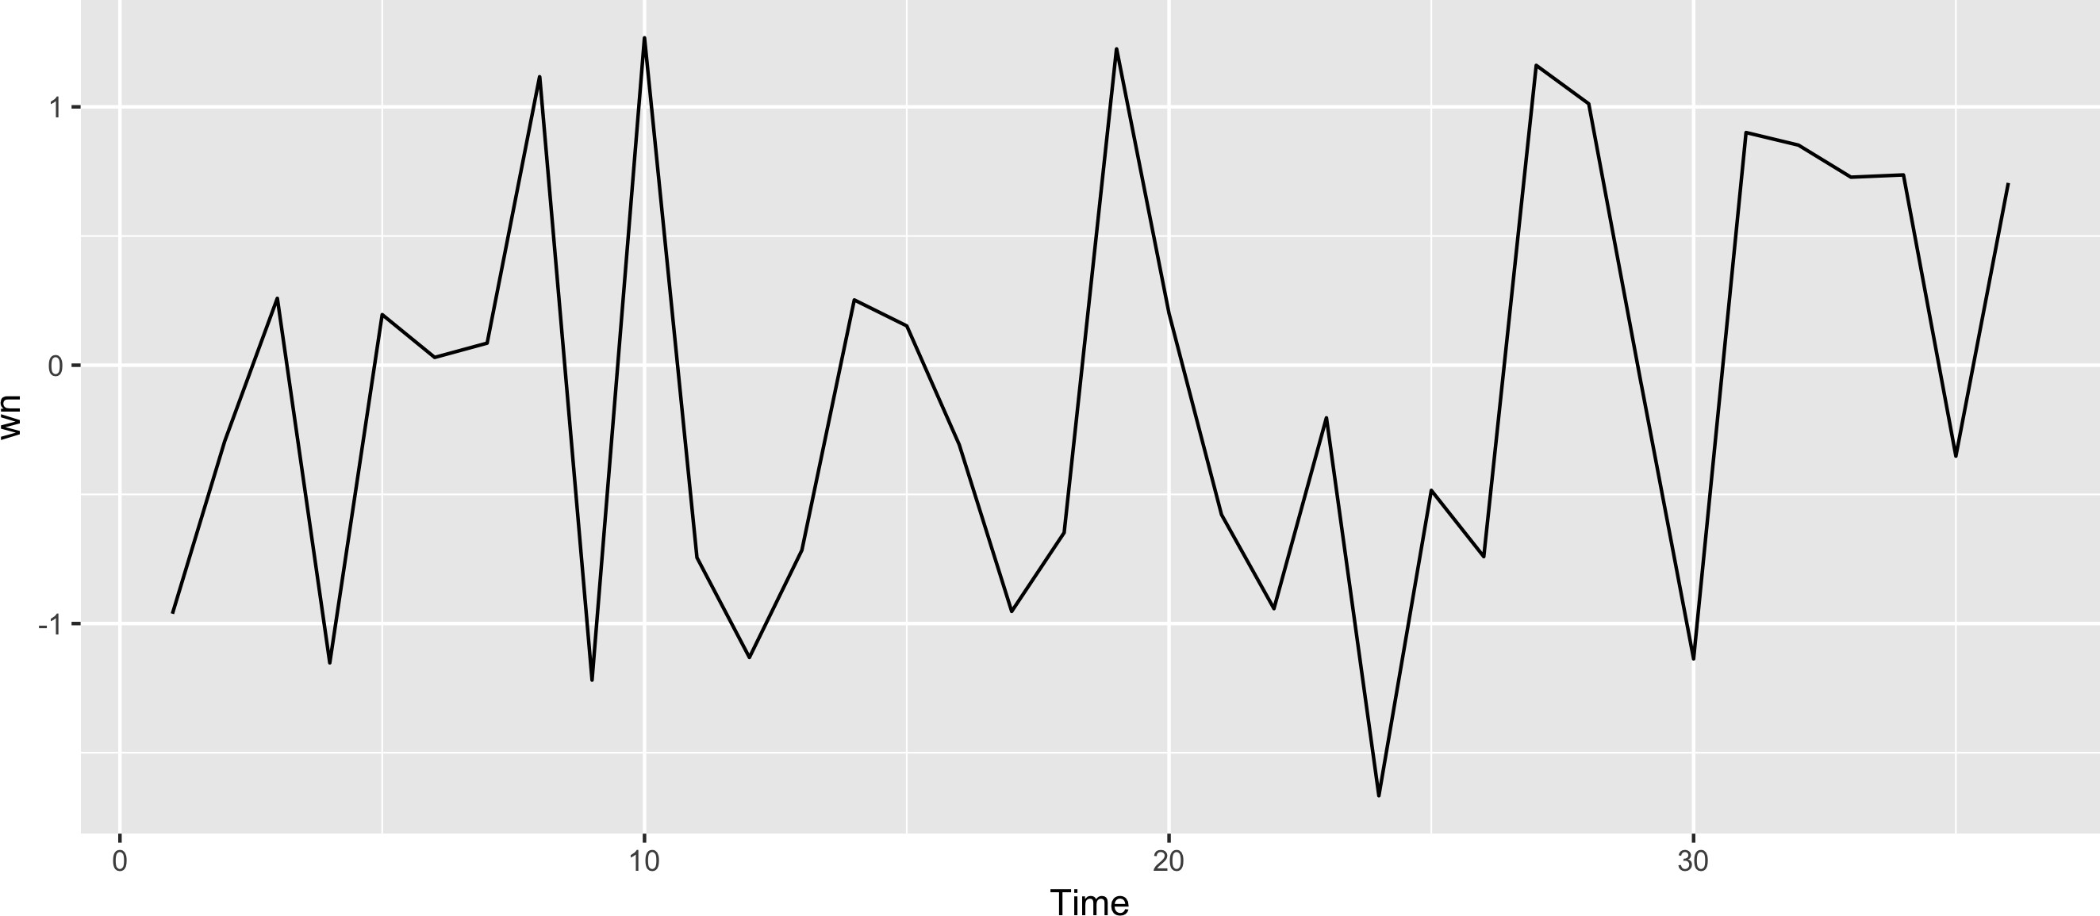
WHITE NOISE
c
set.seed(3) | # | Reproducibility
wn <- ts(rnorm(36)) | # | White noise
autoplot(wn) | # | Plot!
"White noise" is just a time series of iid data

Slide 21
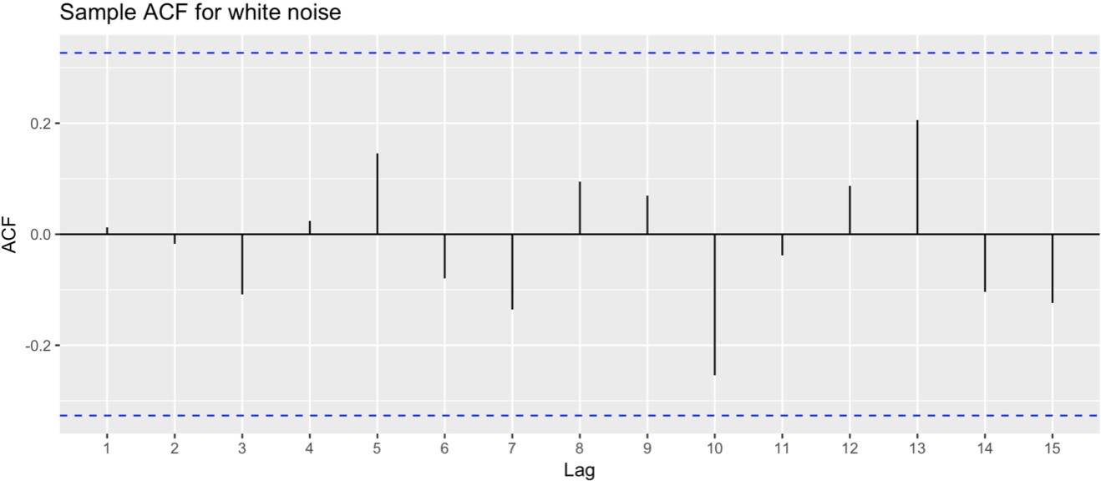
WHITE NOISE ACF
ggAcf(wn) +
ggtitle("Sample ACF for white noise")

Slide 22
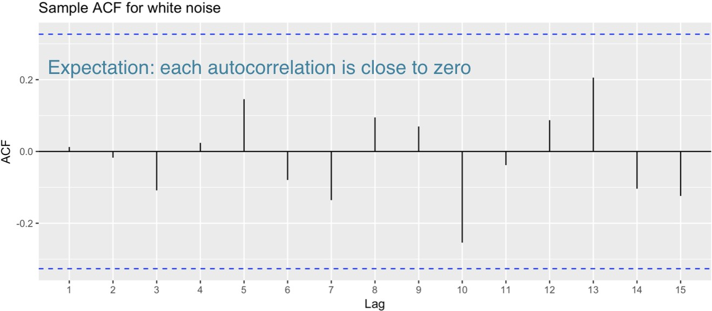
WHITE NOISE ACF
ggAcf(wn) +
ggtitle("Sample ACF for white noise")

Slide 23
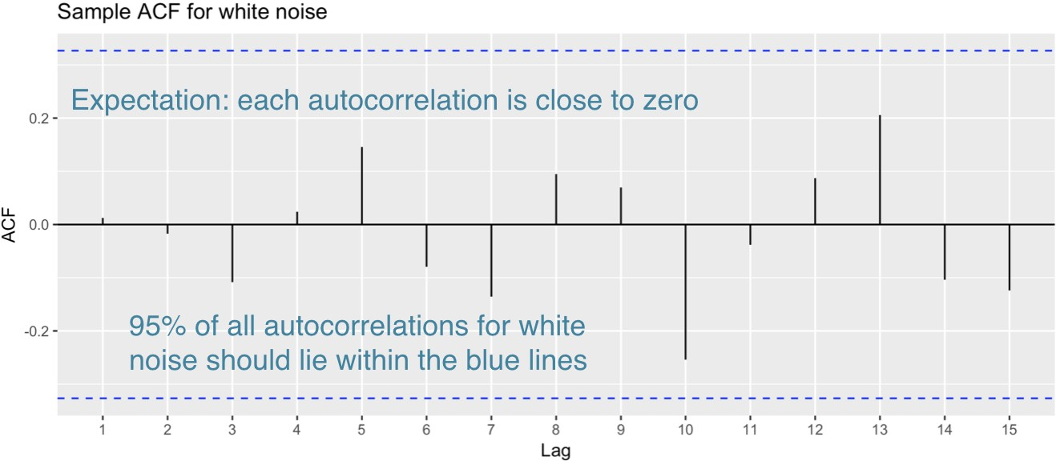
WHITE NOISE ACF
ggAcf(wn) +
ggtitle("Sample ACF for white noise")

Slide 24
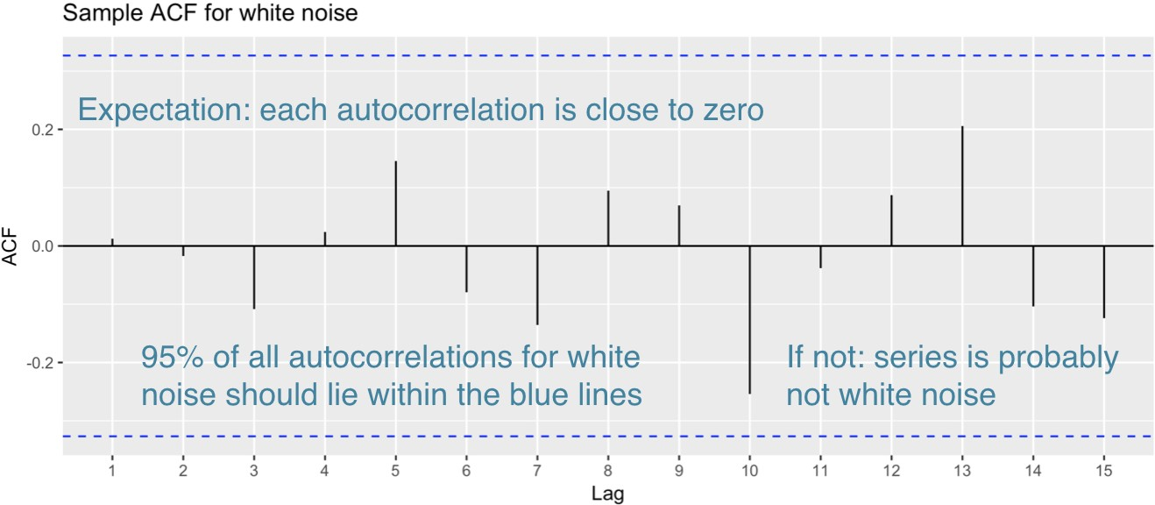
WHITE NOISE ACF
ggAcf(wn) +
ggtitle("Sample ACF for white noise")

Slide 25
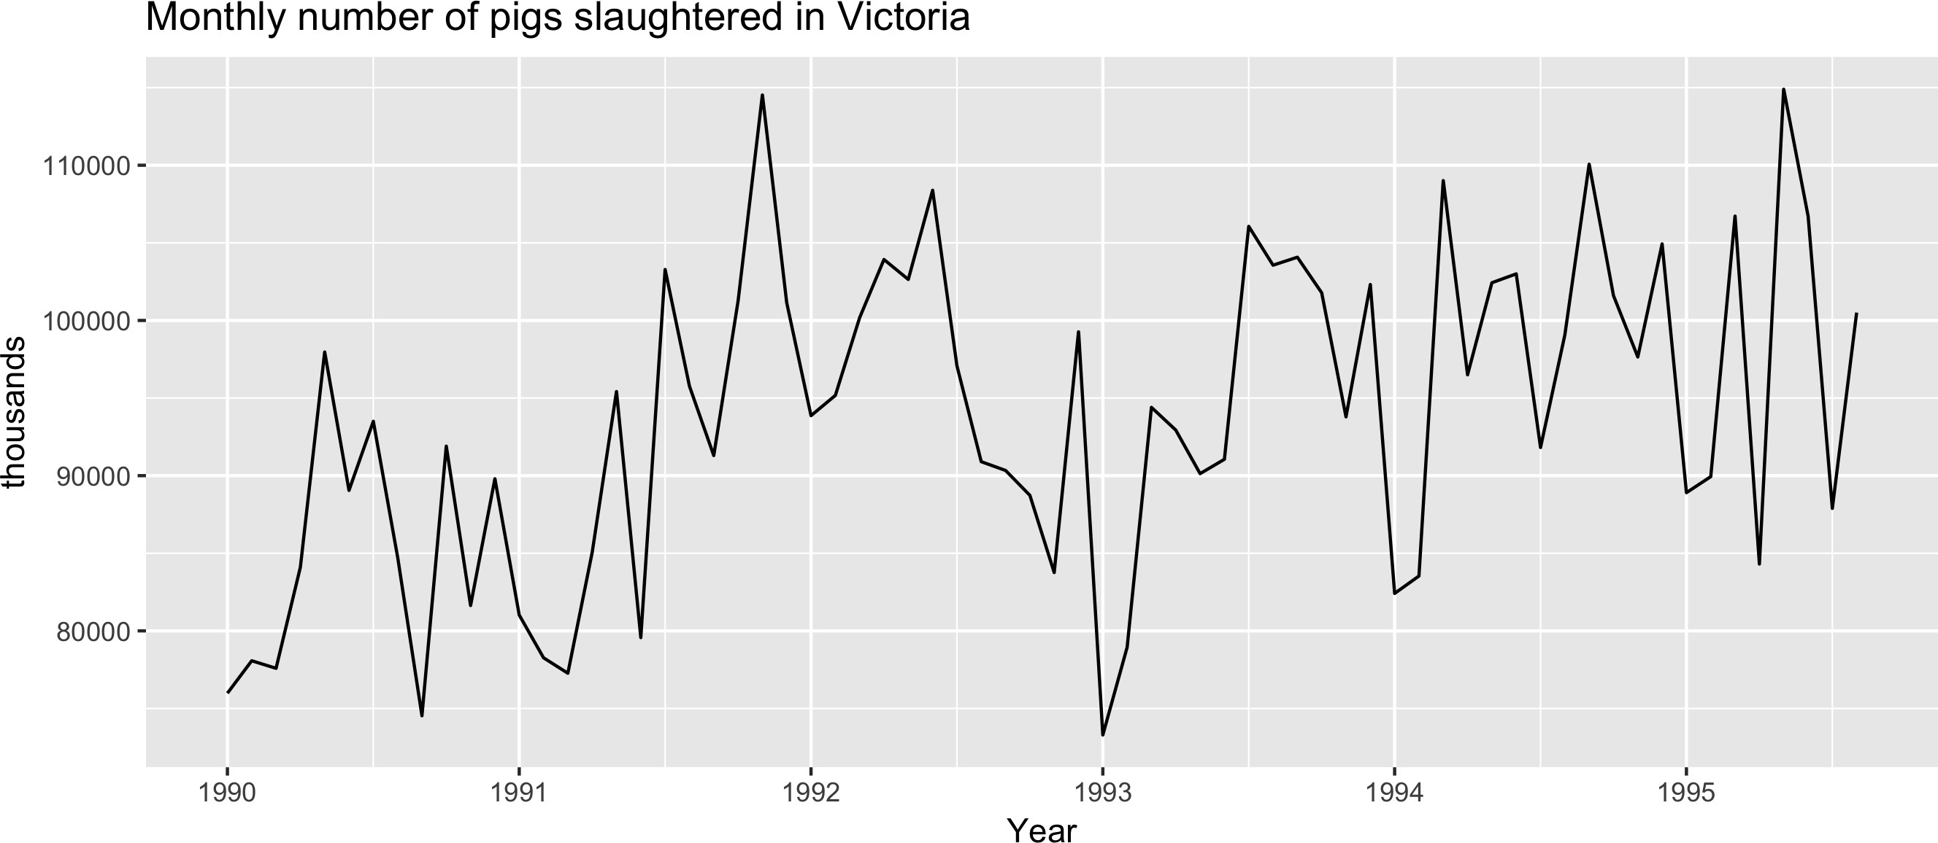
EXAMPLE : PIGS SLAUGHTERED
autoplot(pigs/1000) + xlab("Year") + ylab("thousands") +
ggtitle("Monthly number of pigs slaughtered in Victoria")

Slide 26
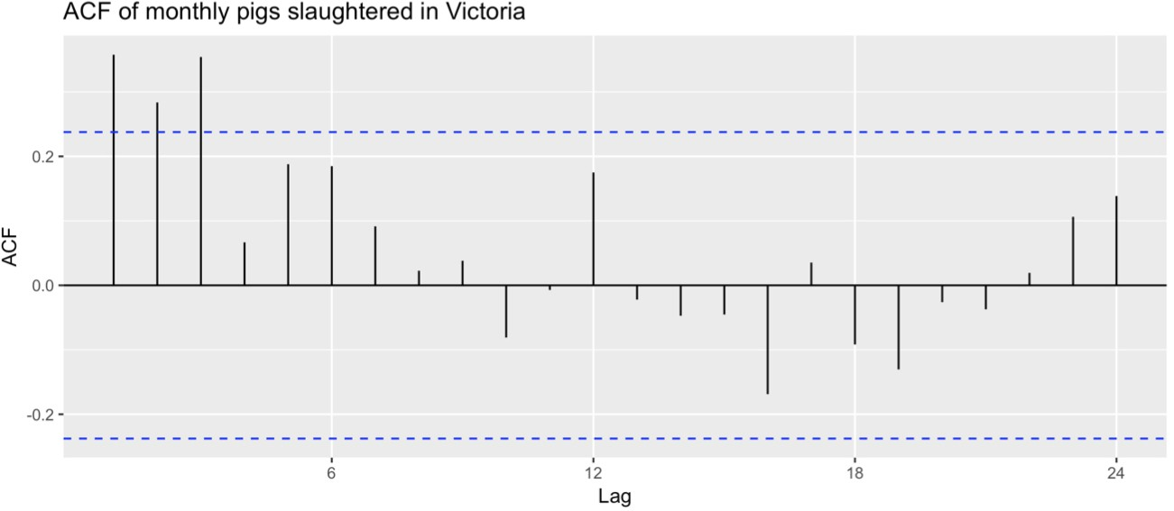
EXAMPLE : PIGS SLAUGHTERED
ggAcf(pigs) +
ggtitle("ACF of monthly pigs slaughtered in Victoria")

Slide 27
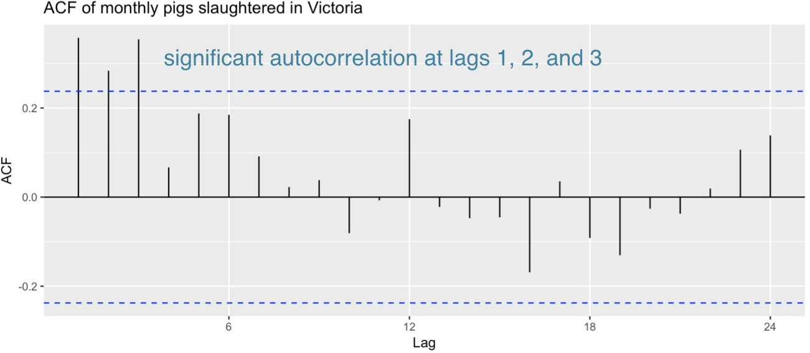
EXAMPLE : PIGS SLAUGHTERED
ggAcf(pigs) +
ggtitle("ACF of monthly pigs slaughtered in Victoria")

Slide 28
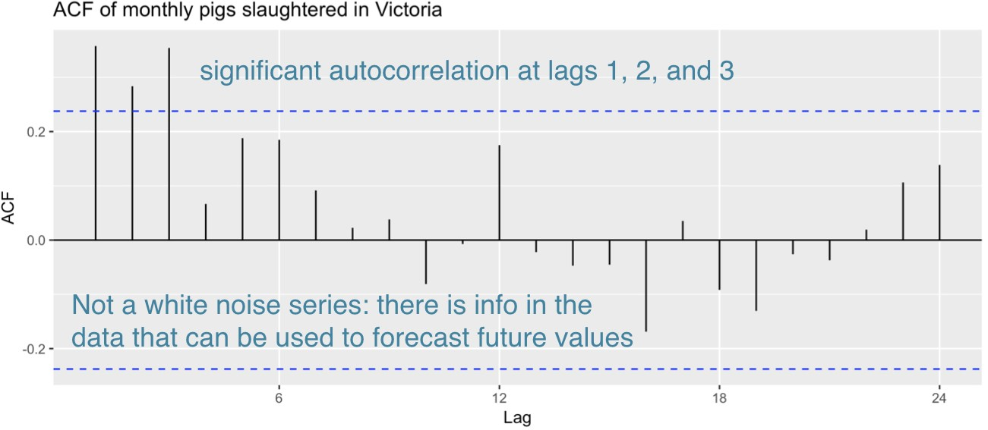
EXAMPLE : PIGS SLAUGHTERED
ggAcf(pigs) +
ggtitle("ACF of monthly pigs slaughtered in Victoria")

Slide 29
LJUNG-BOX TEST
The Ljung-Box test considers the rst h autocorrelation values together.
A signi cant test (small p-value) indicates the data are probably not white noise.
Box.test(pigs, lag = 24, fitdf = 0, type = "Lj")
Box-Ljung test data: pigs
X-squared = 634.15, df = 24, p-value < 2.2e-16

Slide 30
WHITE NOISE SUMMARY
White noise is a time series that is purely random
We can test for white noise by looking at an ACF plot or by doing a Ljung-Box testc

Slide 31
Let's practice! F O R EC AS T I N G I N R

